Slide 1
SS ZG 526: Distributed Computing
Agreement/ Consensus Problem in Distributed Systems
Chittaranjan Hota
Professor, Dept. of Computer Sc. & Information Systems
BITS, Pilani Hyderabad Campus, Hyderabad
hota@hyderabad.bits-pilani.ac.in

Slide 2
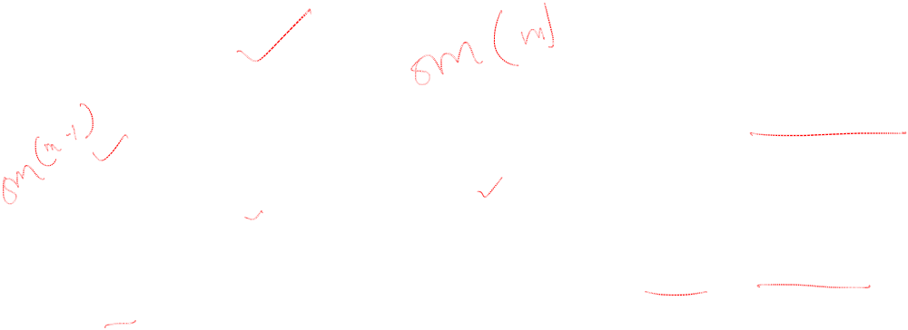
BA: Stages in OM
P1
Stage 0: (n-1) msgs
P2
n-1
Pn
Stage 1: (n-1)(n-2) msgs
P3
n-2
n-2
Pn
Pn-1
P2
.
.
.
.
.
.
.
.
.
P4
Pn
Stage m
.
.
.
Birla Institute of Technology and Science, Pilani (Deemed University)

Slide 3
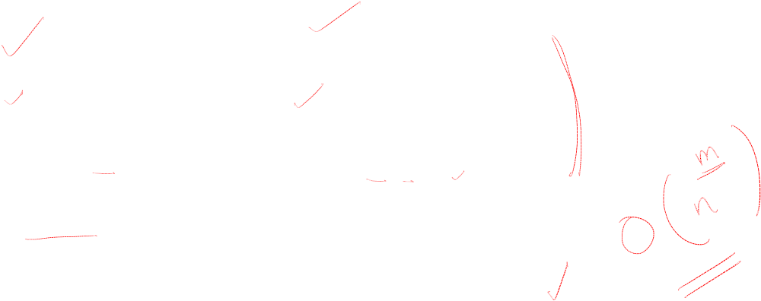
O(n^{m}) Complexity of OM
OM(m) triggers n-1 OM(m-1)
OM(m-1) triggers n-2 OM(m-2)
…
OM(m-k) will be called by (n-1)…(n-k) times
…
OM(0)
Birla Institute of Technology and Science, Pilani (Deemed University)

Slide 4
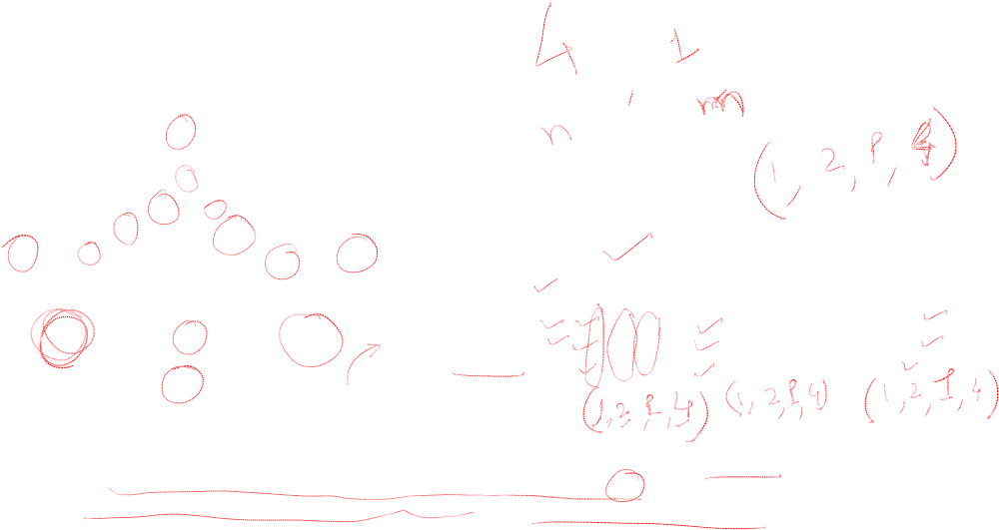
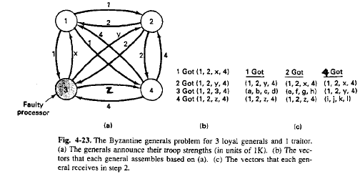
Interactive Consistency Model
Birla Institute of Technology and Science, Pilani (Deemed University)

Slide 5

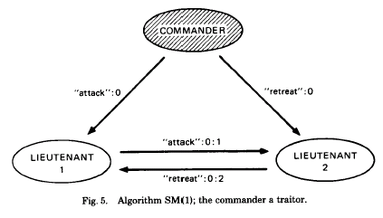
Solution with Signed Messages
We can cope with any number of traitors
Prevent traitors lie about the commander’s order
Messages are signed by commander
The sign can be verified by all loyal lieutenants
All loyals receive the same set of commands eventually
If the commander is loyal, it works
Birla Institute of Technology and Science, Pilani (Deemed University)

Slide 6
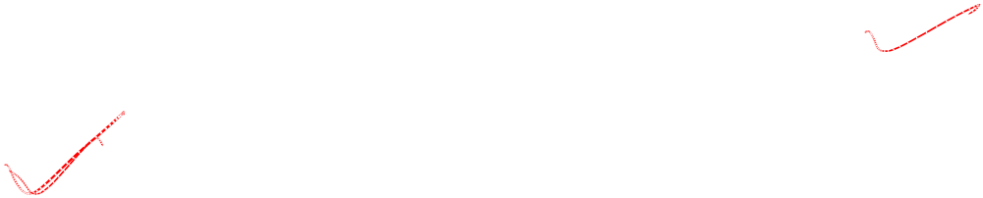
Applications of BA
Building fault tolerant distributed services
  Hardware Clock Synchronization in presence of faulty nodes
  Distributed commit in databases
Birla Institute of Technology and Science, Pilani (Deemed University)

Slide 7
Next module
Peer to Peer Networks
Birla Institute of Technology and Science, Pilani (Deemed University)

